Slide 1



ETHICS WEEK 2025
Empowered by Ethics
Common Ethics Violations: Learn Them and Avoid Them
OGE Investigations Division

Slide 2
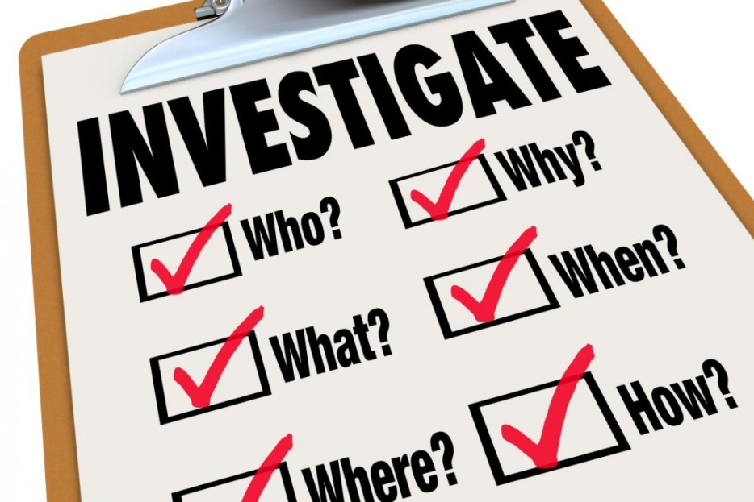


BEGA Overview
BEGA has jurisdiction over the District’s workforce of approximately 35,000 employees, which includes elected officials, legislative and executive branch employees, and members of its independent boards and commissions.

Slide 3
BEGA Overview
What Does BEGA Investigate?
Allegations of ethical misconduct concerning District government employees and Public officials.
District Personnel Manual (DPM) – Chapter 18 (Employee Conduct):
Coordinating Agencies - OIG, OAG, MPD, USAO, and FBI.

Slide 4
Ethics violations
What are the most common violations?
Conflicts of Interest.
Misuse of Gov. Property/Resources/Vehicle.
Outside Employment/Activity
Preferential Treatment/Impartiality
Public Office for Private Gain

Slide 5
Ethics Violations
Outside Our Jurisdiction
Personnel related matters
Hostile work environment/harassment
Retaliation – only if action happened in response to complaint being filed with OGE
Fraud, Waste, and Abuse

Slide 6
Life Cycle of a BEGA Investigation
Intake
Complaints
In-person, Bega mailbox, hotline, online portal
Matter is then assigned to an Investigative Team
Investigation
Undocketed, Preliminary and Formal
Disposition
Dismissal, Informal Admonition, Negotiated Disposition, Notice of Violation and Referral
Complaints are reviewed by the Management team then discussed with Investigative teams

Slide 7


BEGA Investigative Process
How do I submit a BEGA Complaint?
In-Person
Complainant comes in and wants to file an Ethics Complaint
Investigator meets with complainant
Via Mail
Hard copy complaints
Web Portal submission or Via E-mail
BEGA Website complaint link
E-mail to BEGA@dc.gov
Sometimes sworn
Hotline
202-535-1002

Slide 8

BEGA Investigative Process
Case Types:
Formal
  Allegation received with a Sworn Complaint
  Referred from another law enforcement agency
  Presented to the Board within 14 days
Preliminary
Regulatory
  FDS and Lobbyist

Slide 9
BEGA Investigative Process
Determine Need for Investigation
Management Team Review
Attorney Advisor/Investigator Review
Review complaint/ interview complainant (if possible)
Determine Relevant Code of Conduct Violations
Discuss Elements of the Violations
Address Evidence Requirements
Determine Scope

Slide 10
BEGA Investigative Process
Planning The Investigation
Our plan is the key to a proper investigation and the roadmap of how we will conduct the investigation. Our plans are tailored to the particulars of the case and ensure that we will cover all necessary points.
Who do we interview?
What interview order do we follow?
What topics do we cover with each witness?
What documents or records do we need?
What assistance from colleagues or outside resources do we need?

Slide 11
Conflict of Interest
Dave is a district employee responsible for approving urban development projects. The district is considering a new mixed-use development that promises to revitalize neighborhoods East of the River and generate significant tax revenue.
Unbeknownst to most of the selection team, Dave has a personal connection: his spouse Kelly, is a senior executive at the construction firm bidding for the project.
What issues does this situation pose?

Slide 12
Misuse of Government Property
Lisa is an employee for the district. As part of her duties, she has access to a government-issued vehicle, which she uses to transport fellow employees and supplies to other agencies.
One weekend Lisa decides to use the government-issued vehicle for personal errands. She drives it to a nearby shopping mall, goes grocery shopping, and visits some friends, all while off-duty.
Since she has gotten away with using the vehicle before, Lisa decides to take the vehicle to a family reunion, using it to transport her relatives. She justifies her actions by thinking that the gas and maintenance are already covered by the district.

Slide 13
Outside Employment/Activity
Keisha is an administrative assistant in the district government’s public health department. She enjoys her job but finds the salary insufficient to cover her living expenses. To make ends meet, she takes a full-time position as a project manager at a private health consulting firm.
Keisha’s schedule at the government job is 9 AM to 5 PM, while her consulting job requires her to work from 8 AM to 4 PM. To manage both roles, she begins arriving late to her government job and sometimes leaves early, claiming she has personal appointments.
Her performance at the government job begins to slip. Keisha struggles to meet deadlines and is often tired and distracted, leading to mistakes on important documents. Her supervisor notices her declining performance and increased absenteeism.

Slide 14
Preferential Treatment/Impartiality
James Miller is a procurement officer for a municipal government. He is responsible for awarding contracts to vendors for various city projects. James has been working in this role for several years and is well-respected within the department.
James has a close friend, Mike, who owns a construction company. Over the years, they have maintained a strong friendship, often socializing outside of work. Mike's company specializes in public works projects, and James knows he can rely on him for quality work.
When a significant infrastructure project arises, James oversees the bidding process. He is aware that several vendors are interested, including Mike’s company. Despite having a responsibility to evaluate all bids fairly, James feels a strong inclination to support his friend.

Slide 15
Public Office for Private Gain
Natalie is a district government employee who works for Planning and Development. Over time, she developed a keen interest in real estate and began to leverage her position for personal gain.
One day, she received an application for a new commercial development in a prime location. Knowing the project’s approval would significantly increase property values in the area, Natalie contacted the developer privately. She offered to expedite the approval process in exchange for a financial kickback once the project was completed.
As the developer agreed, Natalie manipulated the timelines and misled her colleagues, ensuring the project moved through the necessary approvals without the usual scrutiny. Meanwhile, she started investing in nearby properties, anticipating a surge in value once the new development was complete.

Slide 16


BEGA Investigative Techniques
Research Methods
  PeopleSoft (personnel, time and attendance)
  CLEAR, Lexis Nexus, TLO and the like
  Emails OCTO
  Open Source
    Public (Google, LinkedIn and Social Media)
    Personal and business
  Agency Information and Audits
    Law Enforcement (OIG, OAG, MPD…)
    Regulatory (DHCF, DCHR, OPRS…)

Slide 17

Enforcement Actions
Dispositions:
Negotiated Disposition
Must be approved by the Board after negotiations between OGE and Respondent are finalized; may include fine , public censure or both.
Notice of Violation
Full and adversarial hearing before the Board (discovery and production of documents, witness testimony etc.)
Show Cause Hearing
Requires one or more of the parties to a case to justify, explain, or prove something to the Board. Usually scheduled for respondents, who are not cooperating with the investigation.
Informal Admonition
Normally issued as a warning involving minor violations.
Public Censure
Public reprimanding of a public official for inappropriate conduct or voting behavior.

Slide 18
BEGA Ethics Day
Conclusion
1030 15th Street, NW, 700 West
Washington, DC 20005
Phone: (202) 481-3411
Hotline: (202) 535-1002
Email: bega@dc.gov
Questions?

